Slide 1
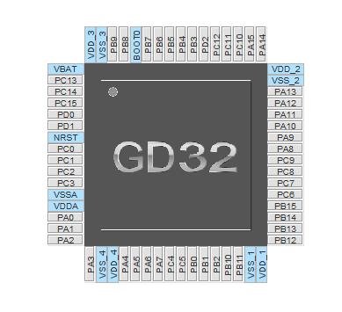
M510 with MT6816 encoder
Battery switch
PAS (green?!)
Encoder Z
DC/DC switch
CLK
Brake
LED
DIO
CAN Tx
OSCIn
CAN Rx
OSC0ut
Timer0 CH2
Timer0 CH1
Timer0 CH0
ADC Battery voltage
Encoder B
Encoder A
Timer0 CH2 ON
ADC Battery Current
Timer0 CH1 ON
Encoder PWM
Timer0 CH0 ON
ADC PhaseA Current
Timer0 BKIN
Speed
ADC Torque
ADC Throttle
ADC PhaseB Current
ADC PhaseC Current
ADC Battery voltage with offset

